Slide 1

Journey
110A
through
by Victorious Secret

Slide 2
Characteristics of a Library
Earthy tones
Comfortable and calm
Knowledge and stimulation

Slide 3
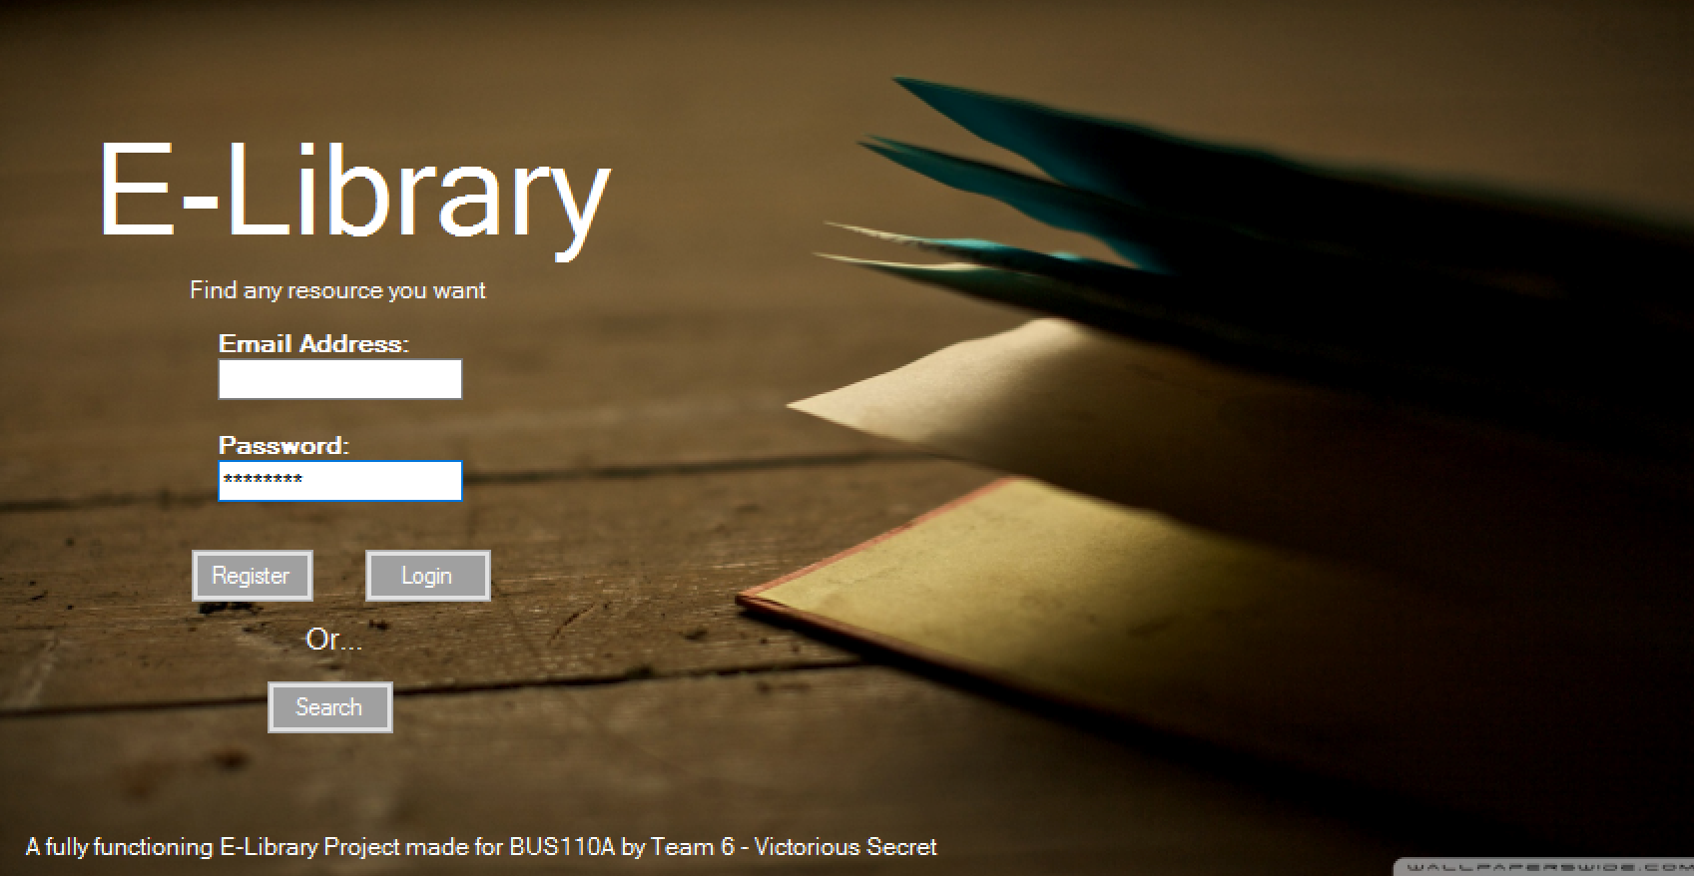
Colors are important.
Mellow
Reliable
Home
Security

Slide 4
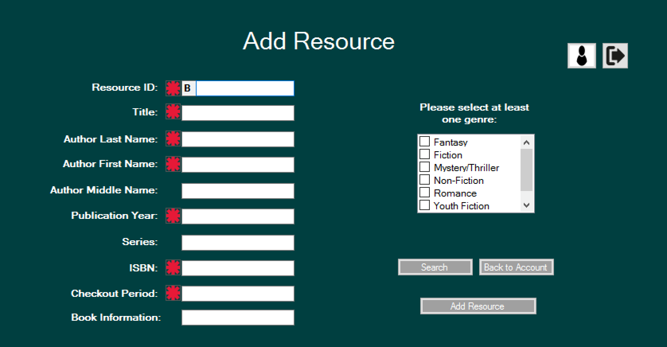
They have meaning.
Rich
Knowledge
Calmness
Depth

Slide 5
Final Project
Member
Log In/Register
Resource Search
Account Review
Check Out
Return/Renew
Employee
Log In
Resource Search
Account Review
Add Resource

Slide 6
Retrospective
Teamwork makes the dream work. (https://docs.google.com/spreadsheets/d/1xb3C1bk0VJQs42WrW4HXfUJXr384HNAEzI4wRB13bNE/edit#gid=0)
Helping hands
Visual Basic: trial and error

Slide 7
Lessons Learned
Scope Creep
Agile
Communication

Slide 8
Thank you.
**Special shoutout to our favorite TAs

